Slide 1


Juan Carlos Galeano
Agosto 31/2024

Slide 2

Outline
Executive Summary
Introduction
Methodology
Results
Conclusion
Appendix

Slide 3
Executive Summary
Summary of methodologies
Data Collection using SpaceX REST API
Data Collection with Web Scraping
Data Wrangling to create success/fail outcome variable
Exploratory Data Analysis using SQL
Exploratory Data Analysis using Python Pandas and Matplotlib
Launch Sites Analysis with Folium-Interactive Visual Analytics and PlotyDash
Machine Learning Landing Prediction to predict landing outcomes using logistic regression, (SVM), decision tree and KNN
Summary of all results
EDA results: Launch success has improved over time, KSC LC-39A has the highest success rate among landing sites, Orbits ES-L1, GEO, HEO, and SSO have a 100% success rate
Interactive Visual Analytics and Dashboards: Most launch sites are near the equator and all are close to the coast
Predictive Analysis(Classification): All models performed similarly on the test set.

Slide 4
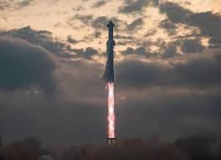
Introduction
Project background and context
Today we are living in a commercial space age in which companies are making space travel a reality for everyone, with SpaceX being the most successful with achievements such as sending spacecraft to the International Space Station, satellite Internet and sending missions manned into space. Rocket launches are relatively inexpensive like the Falcon 9 with a cost of $62 million, a value much lower than its competition because it can reuse the first stage. while other providers cost more than $165 million each.
Therefore, the work aims to determine if the first stage will land, and determine the launch price. To do this, we can use public data and machine learning models to predict whether SpaceX – or a competing company – can reuse the first stage.
Problems you want to find answers
Predict if the Falcon 9 first stage will land successfully using data from Falcon 9 rocket launches
Rate of successful landings over time
Best predictive model for successful landing (classification)

Slide 5

Section 1

Slide 6
Methodology
Executive Summary
Data collection methodology:
Using REST API and web scraping techniques
Perform data wrangling
Filtering the data, handling missing values and preparing the data for analysis and modeling
Perform exploratory data analysis (EDA) using visualization and SQL
Perform interactive visual analytics using Folium and Plotly Dash
Perform predictive analysis using classification models
Predicting landing outcomes using classification models, tuning and evaluating models to find best model.

Slide 7
Data Collection
STAGES
Request data (rocket launch data) from SpaceX API
Response by using .json() and convert to a dataframe using .json_normalize()
Create dictionary from the data
Create dataframe from the dictionary
Filter dataframe by containg only Falcon 9 launches
Wrangle data by replacing missing values with calculated mean() of Payload Mass
Export data to csv file

Slide 8
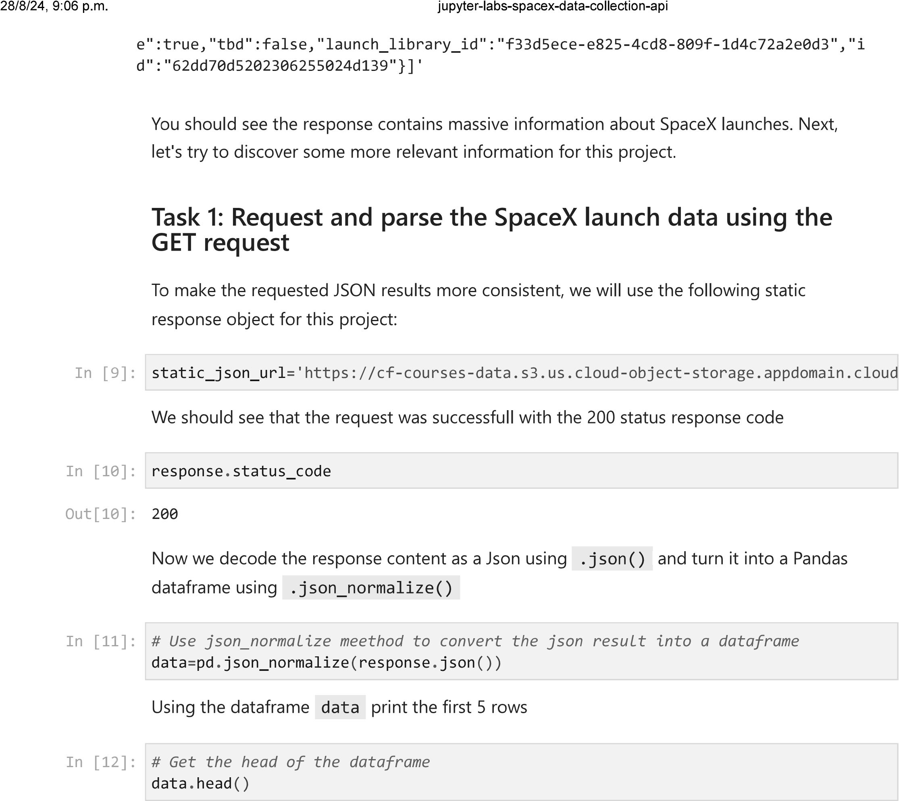
Data Collection – SpaceX API
We collect data using the SpaceX API with Get Requests, then we decode the content of the response as a Json result and use the json_normalize method to convert the json result to a data frame. Adicionally, we filter the dataframe to only include Falcon 9 launches
The GitHub URL of the completed SpaceX API calls notebook https://github.com/Juanchogaleano/SpaceX/blob/main/01-SpaceX-data-collection-api.ipynb

Slide 9
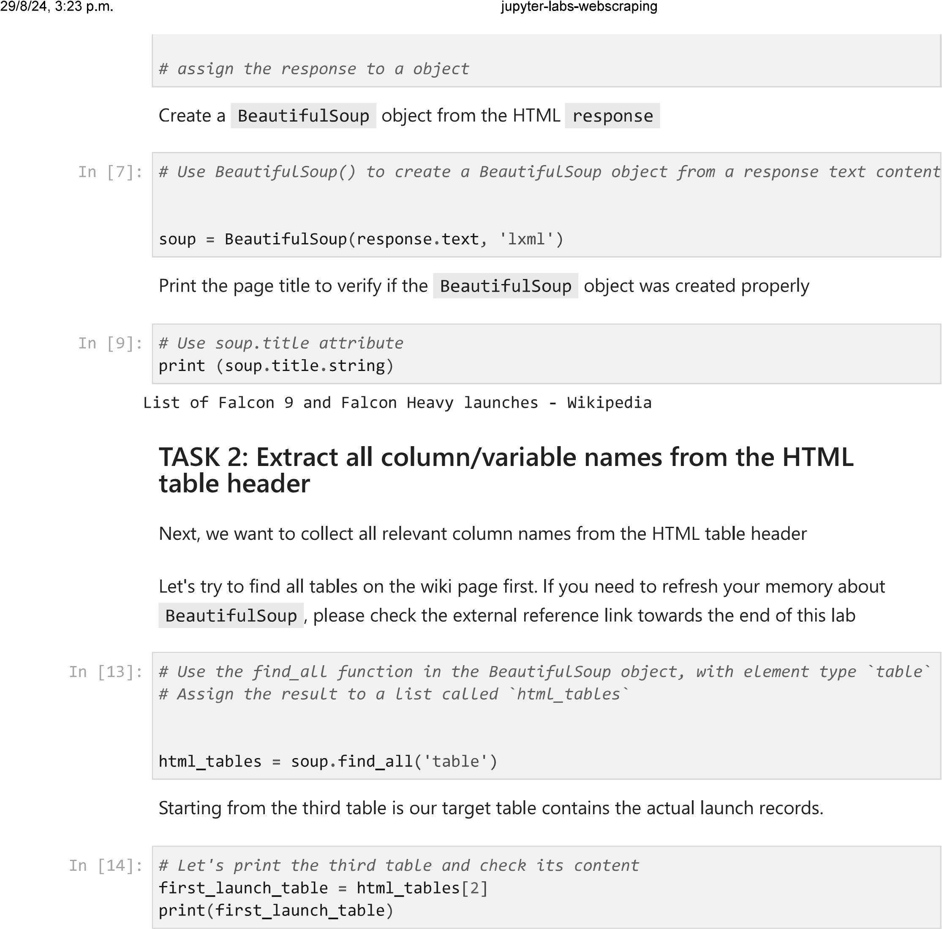
Data Collection - Scraping
We performed web scraping to collect historical Falcon 9 launch logs from Wikipedia using BeautifulSoupand request, then extracted all column/variable names from the HTML table header, create a data frame by parsing the release HTML tables
The GitHub URL of the completed web scraping notebook https://github.com/Juanchogaleano/SpaceX/blob/main/02-SpaceX-webscraping.ipynb

Slide 10
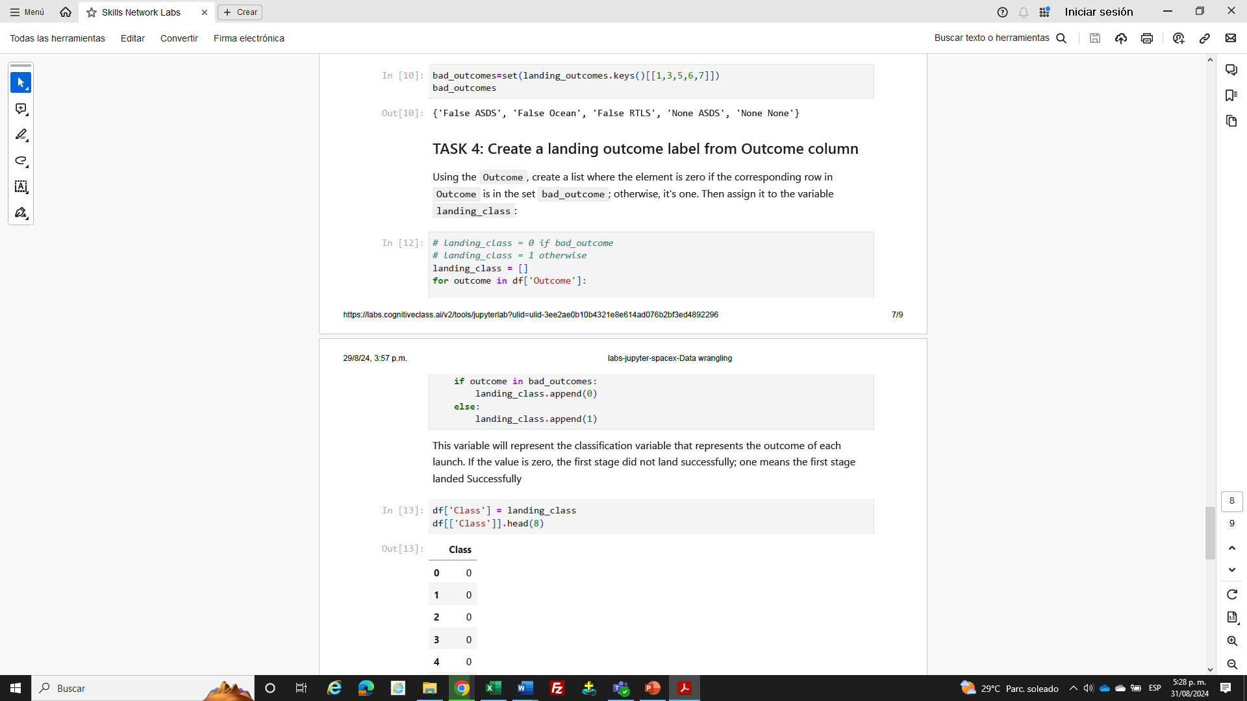
Data Wrangling
We first create a Pandas DF with the collected data, then calculate the number of launches on each site, the number and occurrence of each orbit and the number and occurrence of mission outcome of the orbits. Finally, we create a landing outcome label from Outcome column.
The GitHub URL of your completed data wrangling related notebooks https://github.com/Juanchogaleano/SpaceX/blob/main/03-SpaceX-Data%20wrangling.ipynb

Slide 11
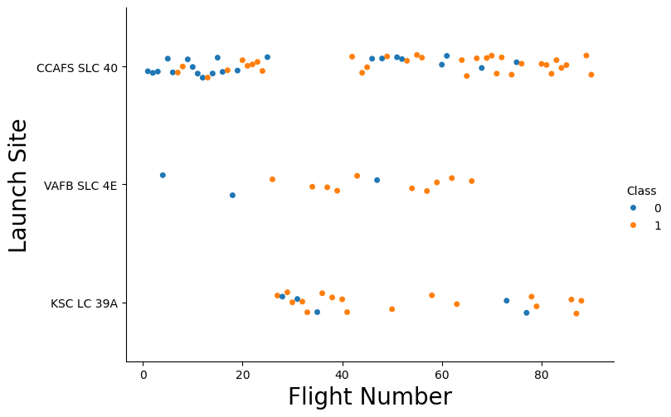
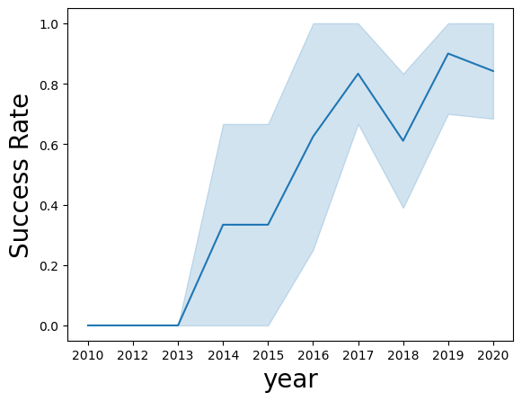
EDA with Data Visualization
Charts plotted
Scatter plot: to visualize the relationship between Flight Number and Launch Site, Flight Number and. Payload Mass(Kg), Payload Mass(Kg) and Launch Site, Flight Number and Orbit type, Payload Mass(Kg) and Orbit type.
Bar chart: to visualize the launch success rate(%) of each orbit type
Line plot: to visualize the launch success rate of each year from 2013
The GitHub URL of your completed EDA with data visualization notebook https://github.com/Juanchogaleano/SpaceX/blob/main/05-SpaceX-Eda-dataviz.ipynb

Slide 12
EDA with SQL
Querys
Display
The names of the unique launch sites in the space mission
5 records where launch sites begin with the string 'CCA’
The total payload mass carried by boosters launched by NASA (CRS)
Average payload mass carried by booster version F9 v1.1
The GitHub URL of your completed EDA with SQL notebook https://github.com/Juanchogaleano/SpaceX/blob/main/04-SpaceX-Eda-sql.ipynb
List
Date when the first succesful landing outcome in ground pad was acheived.
Names of the boosters which have success in drone ship and have payload mass greater than 4000 but less than 6000
Total number of successful and failure mission outcomes
Names of the booster_versions which have carried the maximum payload mass. Use a subquery
Records which will display the month names, failure landing_outcomes in drone ship ,booster versions, launch_site for the months in year 2015.
Rank the count of landing outcomes (such as Failure (drone ship) or Success (ground pad)) between the date 2010-06-04 and 2017-03-20, in descending order.

Slide 13
Interactive Map with Folium
Map objects such as markers, circles, lines, etc. you created and added to a folium map:
Markers indicating Launch Sites
Color blue circle at NASA Johnson Space Center coordinate with a popup label showing its name using its lat and long coordinates
Color red circles at all launch sites coordinates with a popup label showing its name using its name using its lat and long coordinates
Map with Folium
Color Markers of Launch Outcomes: successful(green) and unsuccessful(red) launch show which launch sites have high success rates
Distances Between a Launch Site to Proximities
Color lines show distance from launch site CCAFS SLC-40 and its proximity to the nearest coastline, railway, highway, and city
The GitHub URL of interactive map with Folium map https://github.com/Juanchogaleano/SpaceX/blob/main/06-SpaceX-Launch_site_location.ipynb

Slide 14
Build a Dashboard with Plotly Dash
Plots/graphs and interactions added to dashboard app
Dropdown list with Launch Sites: Allow to user select all or someone launch sites
Pie-chart: Show to user total successful launches by site as a percent of the total or by each site and class(0,1)
Slider: Allow to user select payload mass range
Scatter Chart: Show to user correlation between payload mass and success rate by booster version.
The GitHub URL of Plotly Dash lab https://github.com/Juanchogaleano/SpaceX/blob/main/07-SpaceX-dash_app.py

Slide 15
Predictive Analysis (Classification)
Built, evaluate, improve and identify the best performing classification model with the next steps:
Create a NumPy array from the column Class in data, by applying the method to_numpy()
Standardize the data using the transform
Use the function train_test_split to split the data X and Y into training and test data with the parameter test_size to 0.2
Create object for logistic regression, support vector machine(SVC), decision tree, k nearest neighbors(KNN) with GridSearchCV and then Fit the object to find the best parameters from the dictionary parameters.
Calculate the accuracy on the test data using the method score for all models
Plot the confusion matrix for all models
Find the best model using Jaccard_Score, F1_Score and Accuracy
Add the GitHub URL of your completed predictive analysis lab https://github.com/Juanchogaleano/SpaceX/blob/main/08-SpaceX-Machine%20Learning%20Prediction.ipynb

Slide 16
Results
Exploratory data analysis results
Launch success has improved over time
Orbits ES-L1, GEO, HEO and SSO have a 100% success rate
Interactive analytics demo in screenshots
Predictive analysis results
Decision Tree model is the best predictive model for the dataset

Slide 17

Section 2

Slide 18
Flight Number vs. Launch Site
The new launches have a higher success rate
Launch site from VAFB SLC 4E and KSC LC 39A have higher success rates
The launches for the VAFB SLC 4E site above 50 number of flights have been 100% successful, for the KSC LC 39A site and for the CCAFS SLC site above 40 number of flights
Success rate (blue = fail)
Success rate (orange = success)

Slide 19
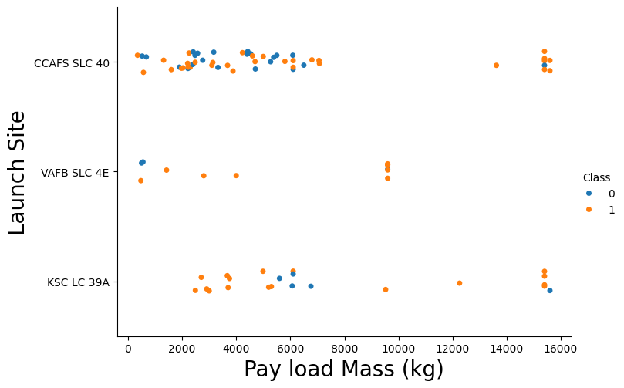
Payload vs. Launch Site
Most lauches with payload greater than 8000 kg were successful
Normally, higher success rate is observed at higher payload mass (kg), around 16000 kg
Most launches from VAFB SKC 4E are successful, but none have been launched above 10,000 kg.
There are not many launches with a payload greater than 10,000kg

Slide 20
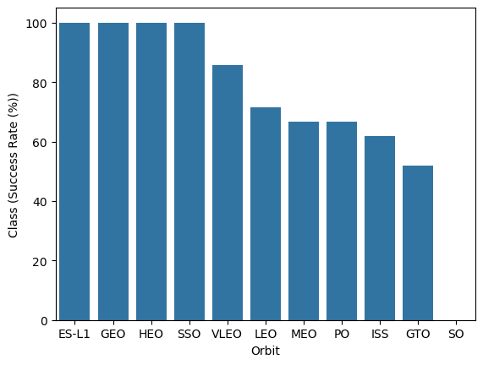
Success Rate vs. Orbit Type
The orbit type ES-L1, GEO, HEO and SSO was 100% Success Rate
The orbit type SO was 0% Success Rate
The other types of orbits (GTO, ISS, LEO, MEO, PO) was between 50%-80% success rate

Slide 21
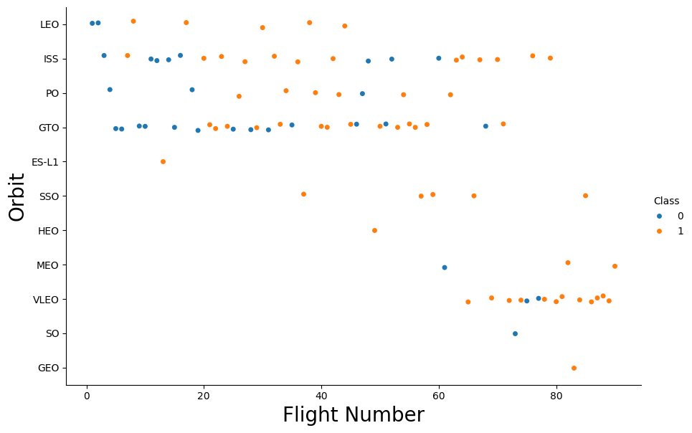
Flight Number vs. Orbit Type
Generally, the greater the number of launches, the greater the success rate of the launches in any of the types of orbit, except GTO orbit.
Some orbits have had 100% success rates for any number of flights such as SSO, HEO y GEO

Slide 22
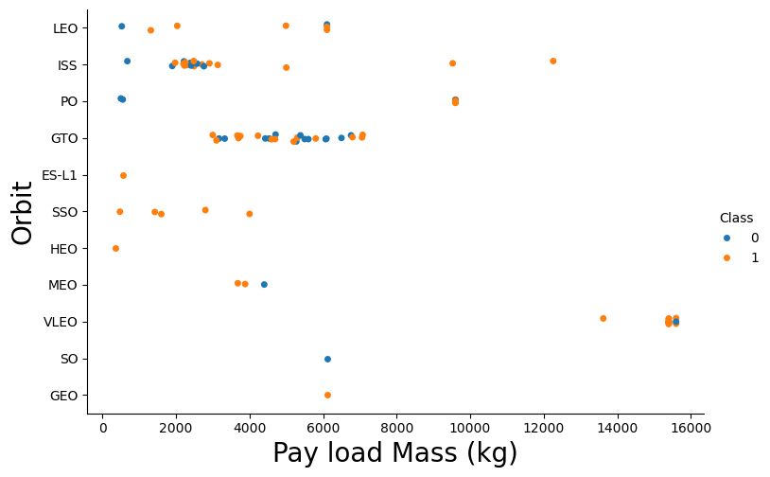
Payload vs. Orbit Type
With heavy payloads, the successful landing rate is higher for PO, LEO and ISS orbits
The GTO orbit has not had a stable trend. Their results are dissimilar for any payloads mass.

Slide 23
Launch Success Yearly Trend
Since 2013, the success rate has been significantly increasing; However, the success rate decreased in 2018 and 2020
Since 2016 the success rate is above 50%

Slide 24
All Launch Site Names
The names of the unique launch sites in the space mission are:
CCAFS LC-40
VAFB SLC-4E
KSC LC-39A
CCAFS SLC-40
I used SELECT DISTINCT statement to obtain the unique launch sites using the ‘LAUNCH_SITE’ column of the SPACEXTBL table
Task 1
Display the names of the unique launch sites in the space mission
%sql SELECT DISTINCT LAUNCH_SITE FROM SPACEXTBL;
* sqlite:///my_data1.db Done.
Launch_Site
CCAFS LC-40
VAFB SLC-4E
KSC LC-39A
CCAFS SLC-40

Slide 25
Launch Site Names Begin with 'CCA'
5 records where launch sites begin with `CCA`
I used SELECT statement and LIKE command to obtain the launch sites using the LAUNCH_SITE column begin with the string CCA% of the SPACEXTBL table
Task 2
Display 5 records where launch sites begin with the string 'CCA'
%sql SELECT * \ FROM SPACEXTBL \ WHERE LAUNCH_SITE LIKE 'CCA%' LIMIT 5;
* sqlite:///my_data1.db Done.
Date Time (UTC) Booster_Version Launch_Site Payload PAYLOAD_MASS__KG_ Orbit Cu
2010- 06-04 18:45:00 F9 v1.0 B0003 CCAFS LC- 40 Dragon Spacecraft Qualification Unit 0 LEO
2010- 12-08 15:43:00 F9 v1.0 B0004 CCAFS LC- 40 Dragon demo flight C1, two CubeSats, barrel of Brouere cheese 0 LEO (ISS)
2012- 05-22 7:44:00 F9 v1.0 B0005 CCAFS LC- 40 Dragon demo flight C2 525 LEO (ISS)
2012- 10-08 0:35:00 F9 v1.0 B0006 CCAFS LC- 40 SpaceX CRS-1 500 LEO (ISS)
2013- 03-01 15:10:00 F9 v1.0 B0007 CCAFS LC- 40 SpaceX CRS-2 677 LEO (ISS)

Slide 26
Total Payload Mass
Total payload carried by boosters from NASA was 45.596 Kg
I used SELECT statement and SUM function to obtain ‘Total payload’ using the PAYLOAD_MASS__KG_ column of the SPACEXTBL table where CUSTOMER = 'NASA (CRS)'
Task 3
Display the total payload mass carried by boosters launched by NASA (CRS)
%sql SELECT SUM(PAYLOAD_MASS__KG_) \ FROM SPACEXTBL \
WHERE CUSTOMER = 'NASA (CRS)';
* sqlite:///my_data1.db Done.
SUM(PAYLOAD_MASS__KG_)
45596

Slide 27
Average Payload Mass by F9 v1.1
The average payload mass carried by booster version F9 v1.1 was 2928.4 Kg
I used SELECT statement and AVG function to obtain ‘Average payload’ using the PAYLOAD_MASS__KG_ column of the SPACEXTBL table where BOOSTER_VERSION = 'F9 v1.1'
Task 4
Display average payload mass carried by booster version F9 v1.1
%sql SELECT AVG(PAYLOAD_MASS__KG_) \ FROM SPACEXTBL \ WHERE BOOSTER_VERSION = 'F9 v1.1';
* sqlite:///my_data1.db Done.
AVG(PAYLOAD_MASS__KG_)
2928.4

Slide 28
First Successful Ground Landing Date
The dates of the first successful landing outcome on ground pad was 2018-07-22
I used SELECT statement and MIN function to obtain ‘the dates of the first successful landing outcome on ground pad’ using the DATE column of the SPACEXTBL table where Landing_Outcome = 'Success'
Task 5
List the date when the first succesful landing outcome in ground pad was acheived.
Hint:Use min function
%sql select min(DATE) from SPACEXTBL \ WHERE Landing_Outcome = 'Success';
* sqlite:///my_data1.db Done.
min(DATE)
2018-07-22

Slide 29
Successful Drone Ship Landing with Payload between 4000 and 6000
Names of booster version which have successfully landed on drone ship and had payload mass greater than 4000 but less than 6000
F9 FT B1022
F9 FT B1026
F9 FT B1021.2
F9 FT B1031.2
I used SELECT statement to obtain ‘names of booster version’ using the ‘Booster_Version‘ column of the SPACEXTBL table where Landing_Outcome = 'Success (drone ship)' and PAYLOAD_MASS__KG_ was BETWEEN 4000 and 6000
Task 6
List the names of the boosters which have success in drone ship and have payload mass greater than 4000 but less than 6000
%sql select Booster_Version from SPACEXTBL \ where Landing_Outcome = 'Success (drone ship)' \ and PAYLOAD_MASS__KG_ BETWEEN 4000 and 6000;
* sqlite:///my_data1.db Done.
Booster_Version
F9 FT B1022
F9 FT B1026
F9 FT B1021.2
F9 FT B1031.2

Slide 30
Total Number of Successful and Failure Mission Outcomes
Task 7
List the total number of successful and failure mission outcomes
%sql SELECT MISSION_OUTCOME, COUNT(*) as total_number \ FROM SPACEXTBL \ GROUP BY MISSION_OUTCOME;
* sqlite:///my_data1.db Done.
Mission_Outcome total_number
Failure (in flight) 1
Success 98
Success 1
Success (payload status unclear) 1
The total number of successful and failure mission outcomes was:
Mission_Outcome total_number
Failure (in flight) 1
Success 98
Success 1
Success (payload status unclear) 1
I used SELECT statement and COUNT function to obtain ‘Total successful and failure mission outcomes’ using the ‘MISSION_OUTCOME‘ column of the SPACEXTBL table grouping by the same column

Slide 31
Boosters Carried Maximum Payload
Names of the booster version which have carried the maximum payload mass was:
F9 B5 B1048.4
F9 B5 B1049.4
F9 B5 B1051.3
F9 B5 B1056.4
F9 B5 B1048.5
F9 B5 B1051.4
F9 B5 B1049.5
F9 B5 B1060.2
F9 B5 B1058.3
F9 B5 B1051.6
F9 B5 B1060.3
F9 B5 B1049.7
I used SELECT statement and MAX function to obtain ‘Names of the booster version ’ using the ‘BOOSTER_VERSION‘ column of the SPACEXTBL table with the maximum payload mass kg
Task 8
List the names of the booster_versions which have carried the maximum payload mass. Use a subquery
%sql select BOOSTER_VERSION as boosterversion \ from SPACEXTBL \ where PAYLOAD_MASS__KG_=(select max(PAYLOAD_MASS__KG_) from SPACEXTBL);
* sqlite:///my_data1.db Done.
boosterversion
F9 B5 B1048.4
F9 B5 B1049.4
F9 B5 B1051.3
F9 B5 B1056.4
F9 B5 B1048.5
F9 B5 B1051.4
F9 B5 B1049.5
F9 B5 B1060.2
F9 B5 B1058.3
F9 B5 B1051.6
F9 B5 B1060.3
F9 B5 B1049.7

Slide 32
2015 Launch Records
The failed landing_outcomes in drone ship, their booster versions, and launch site names for in year 2015 was:
month Date Booster_Version Launch_Site Landing_Outcome
5- 2015-01-10 F9 v1.1 B1012 CCAFS LC-40 Failure (drone ship)
5- 2015-04-14 F9 v1.1 B1015 CCAFS LC-40 Failure (drone ship
I used SELECT statement to obtain for 2015 and failed landing outcome in dron ship using month, date, Booster version, Launch site and landing outcome column of the SPACEXTBL table.
Task 9
List the records which will display the month names, failure landing_outcomes in drone ship ,booster versions, launch_site for the months in year 2015.
Note: SQLLite does not support monthnames. So you need to use substr(Date, 6,2) as month to get the months and substr(Date,0,5)='2015' for year.
%sql SELECT substr(Date,4,2) as month, DATE,BOOSTER_VERSION, LAUNCH_SITE, Landing_O FROM SPACEXTBL \ where Landing_Outcome = 'Failure (drone ship)' and substr(Date,0,5)='2015';
* sqlite:///my_data1.db Done.
month Date Booster_Version Launch_Site Landing_Outcome
5- 2015-01-10 F9 v1.1 B1012 CCAFS LC-40 Failure (drone ship)
5- 2015-04-14 F9 v1.1 B1015 CCAFS LC-40 Failure (drone ship)

Slide 33
Rank Landing Outcomes Between 2010-06-04 and 2017-03-20
Rank the count of landing outcomes between the date 2010-06-04 and 2017-03-20 was
Landing_Outcome count_outcomes
No attempt 10
Success (drone ship) 5
Failure (drone ship) 5
Success (ground pad) 3
Controlled (ocean) 3
Uncontrolled (ocean) 2
Failure (parachute) 2
Precluded (drone ship) 1
I used SELECT statement and COUNT function to obtain between 2010-06-04 and 2017-03-20 the count outcome in landing outcome using Landing_Outcome column of the SPACEXTBL table by count descending.
Task 10
Rank the count of landing outcomes (such as Failure (drone ship) or Success (ground pad)) between the date 2010-06-04 and 2017-03-20, in descending order.
%sql SELECT Landing_Outcome, count(*) as count_outcomes \ FROM SPACEXTBL \ WHERE DATE BETWEEN '2010-06-04' AND '2017-03-20' \ group by Landing_Outcome order by count_outcomes DESC;
* sqlite:///my_data1.db Done.
Landing_Outcome count_outcomes
No attempt 10
Success (drone ship) 5
Failure (drone ship) 5
Success (ground pad) 3
Controlled (ocean) 3
Uncontrolled (ocean) 2
Failure (parachute) 2
Precluded (drone ship) 1

Slide 34

Section 3

Slide 35
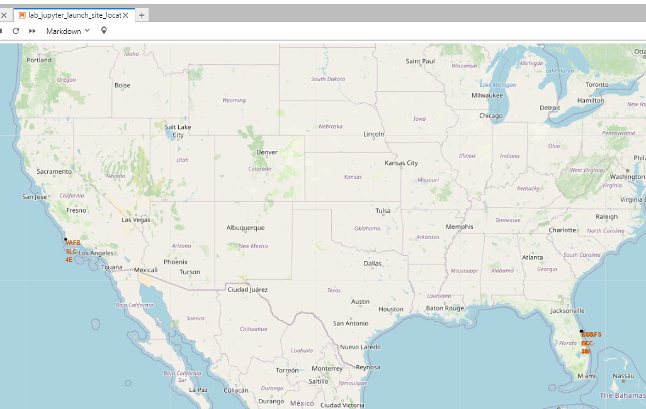
Markers of all SpaceX launch sites
All launch sites are in near to the Equator, located southwards of the US.
All the launch sites are very close to the coast.
Launches from sites close to the equator and due to the speed of the Earth's rotation help to have lower fuel consumption.

Slide 36
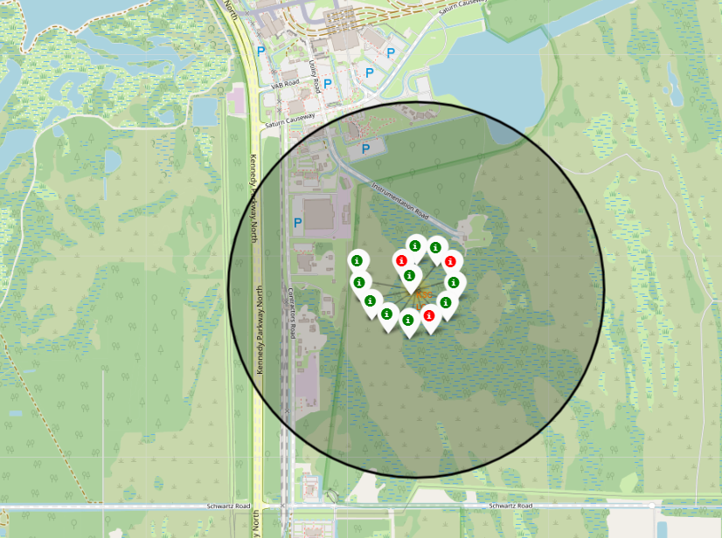
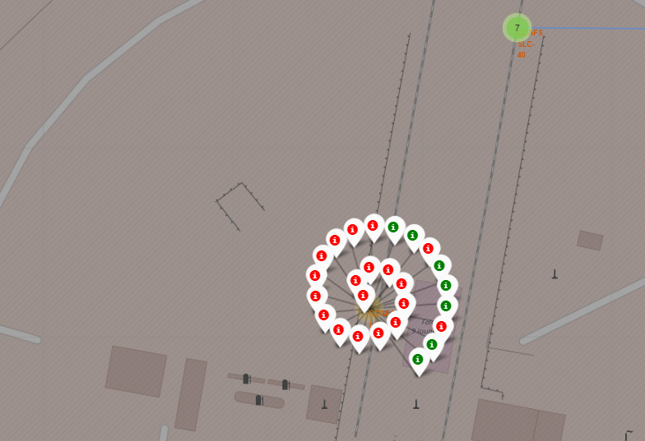
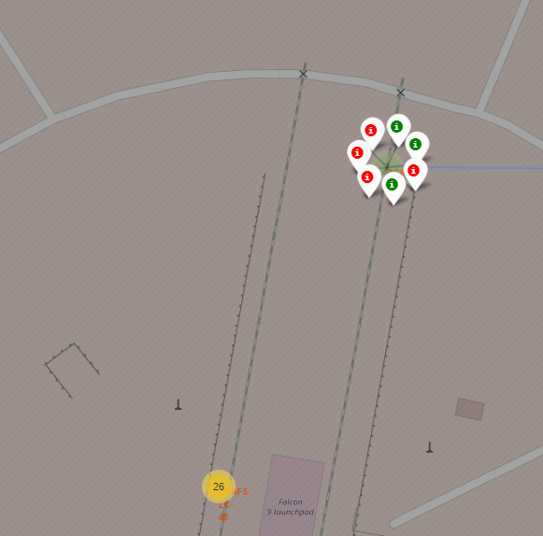
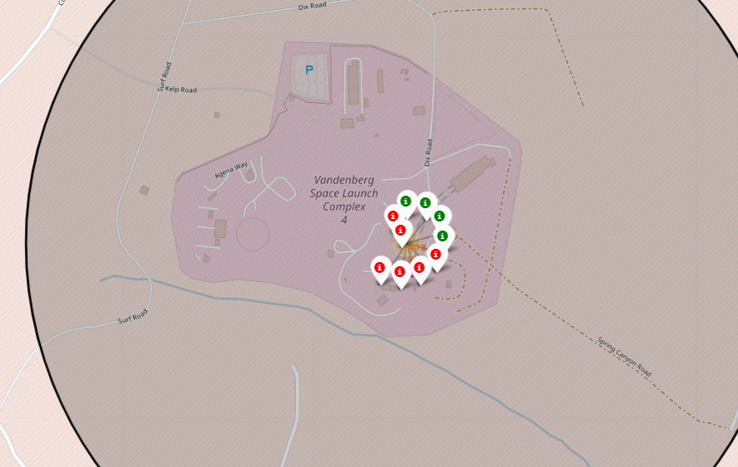
Launch outcomes for each site
Green markers for successful launches
Red markers for unsuccessful launches
The map shows that 3 of 7 launches for the CCAFS SLC-40 site have been successful
Launch site KSC LC-39A has high success rates compared to CCAFS SLC-40 & CCAFS LC-40 in the Eastern coast (Florida)

Slide 37
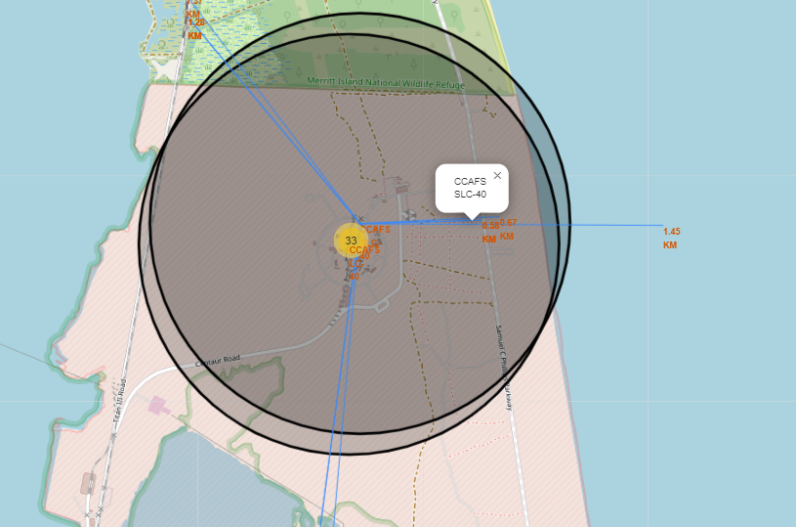
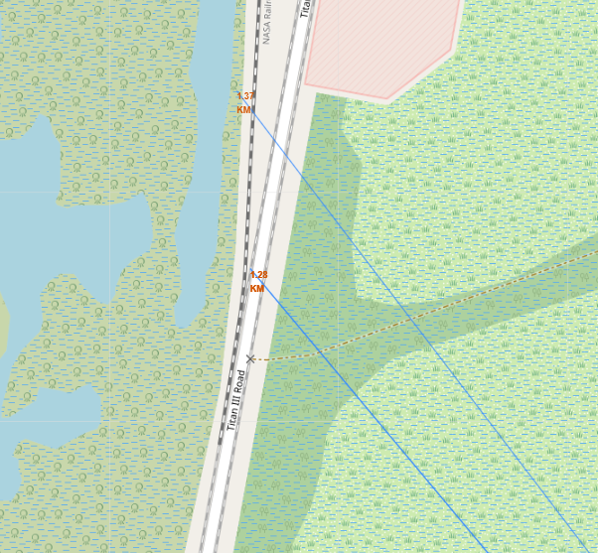
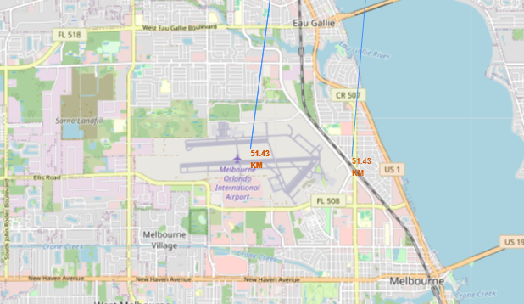
Distances between a launch site to its proximities
Site CCAFS SLC-40
City Distance(Melbourne) 51.43 km
Railway Distance(Nasa raillroad) 1.37 km
Highway Distance(Samuel P HW) 0.67 km
Coastline Distance 1.45 km

Slide 38

Section 4

Slide 39
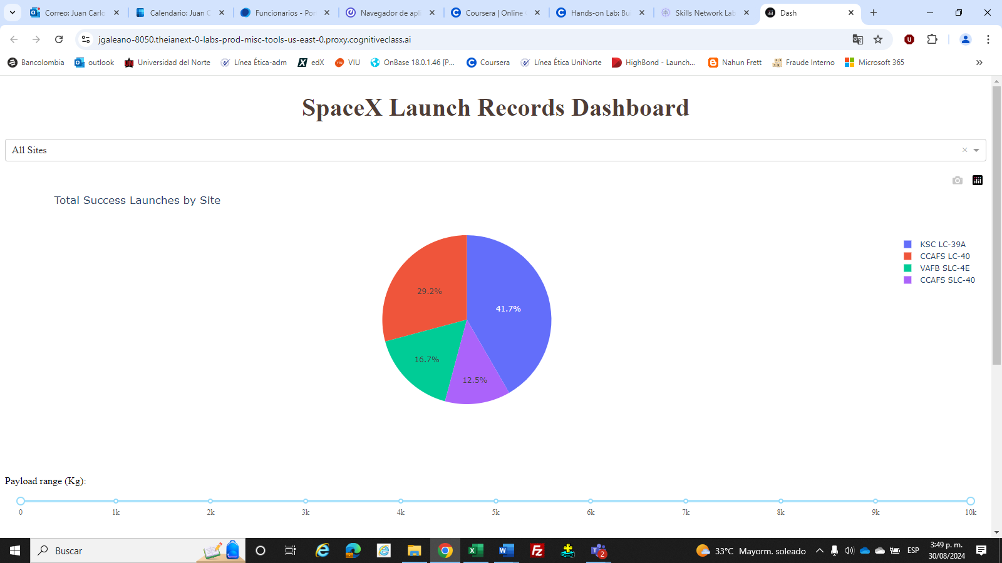
Launch success by site
Success as Percent of Total
Launch site KSC LC-39A has the highest success rate at 41.7. The site CCAFS LC-40 has at 29.2%, VAFB SLC-4E has at 16.7% and CCAFS SLC-40 with a success rate of 12.5%

Slide 40
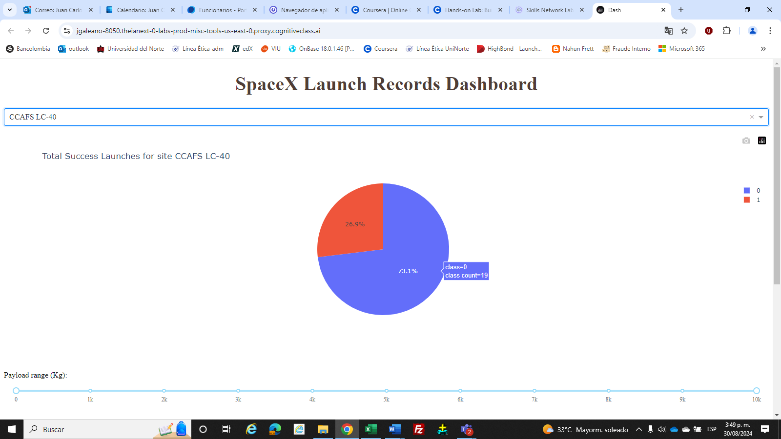
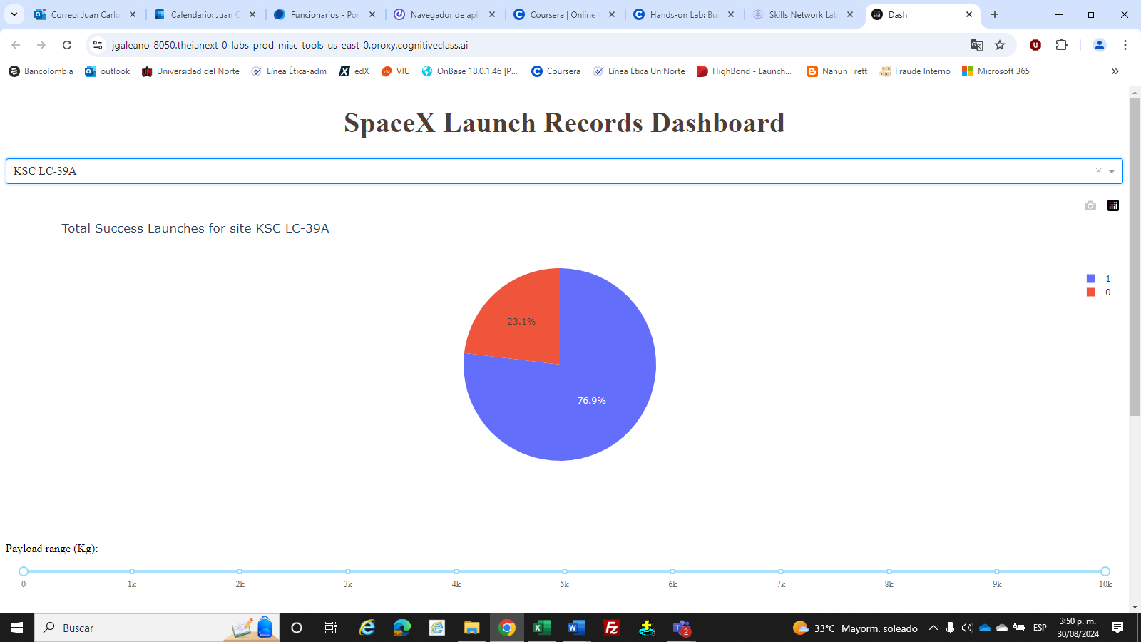
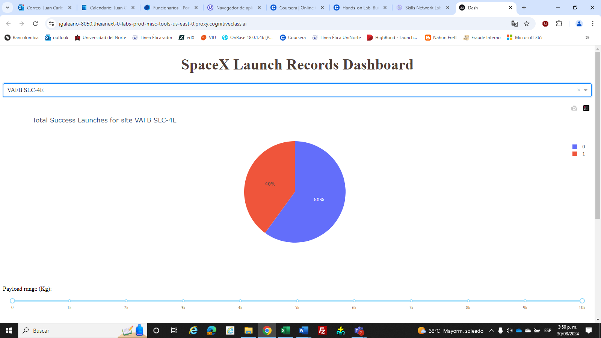

Launch site with success ratio
Success as Percent of Total by site:
KSC LC-39A : 76.9%
CCAFS SLC-40 : 42.9%
VAFB SLC-4E : 40.0%
CCAFS SL-40 : 26.9%
The launch site highest success rate was KSC LC-39A 76.9%

Slide 41
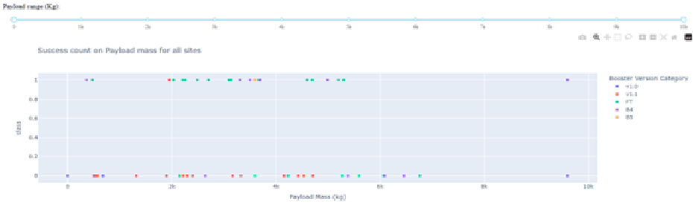
Payload mass and success by bosster version
Launch by booster version has the largest success rate from a payload mass greater than 2000 kg
The highest success rate had by booster version F1

Slide 42

Section 5

Slide 43
Classification Accuracy
All the models (SVM, LR,KNN, decision tree) performed at about the same level and had the same scores and accuracy on the test data.
The accuracy score was 83.33%
TASK 12
Find the method performs best:
accuracy = [svm_cv_score, logreg_score, knn_cv_score, tree_cv_score]
accuracy = [i * 100 for i in accuracy]
method = ['Support Vector Machine', 'Logistic Regression', 'K Nearest Neighbour', 'Decision Tree']
models = {'ML Method':method, 'Accuracy Score (%)':accuracy}
ML_df = pd.DataFrame(models)
ML_df
ML Method Accuracy Score (%)
0 Support Vector Machine 83.333333
1 Logistic Regression 83.333333
2 K Nearest Neighbour 83.333333
3 Decision Tree 83.333333

Slide 44

Confusion Matrix
All the 4 classification model had the same confusion matrixes.
A confusion matrix summarizes the performance of a classification algorithm
Confusion Matrix Outputs were:
12 True positive
3 True negative
3 False positive
0 False Negative

Slide 45
Conclusions
The launch site are CCAFS LC-40 , VAFB SLC-4E, KSC LC-39A and CCAFS SLC-40. All launch sites are in near to the Equator, located southwards of the US and are very close to the coast.
Launch site KSC LC-39A has the highest success rate at 41.7 of all site and your Success as Percent of Total by site was 76.9%
Launch by booster version has the largest success rate from a payload mass greater than 2000 kg and the highest success rate had by booster version F1
Since 2013, the success rate has been significantly increasing; However, the success rate decreased in 2018 and 2020. Since 2016 the success rate is above 50%
Generally, the greater the number of launches, the greater the success rate of the launches in any of the types of orbit, except GTO orbit. Some orbits have had 100% success rates for any number of flights such as SSO, HEO y GEO. With heavy payloads, the successful landing rate is higher for PO, LEO and ISS orbits. The GTO orbit has not had a stable trend. Their results are dissimilar for any payloads mass. The orbit type SO was 0% Success Rate
Normally, higher success rate is observed at higher payload mass (kg), around 16000 kg and most launches from VAFB SKC 4E are successful, but none have been launched above 10,000 kg.
The launches for the VAFB SLC 4E site above 50 number of flights have been 100% successful, for the KSC LC 39A site and for the CCAFS SLC site above 40 number of flights
All the models (SVM, LR,KNN, decision tree) performed at about the same level and had the same scores and accuracy on the test data. The accuracy score of the models was 83.33% and all models had the same confusion matrices. The main problem is false positives for all the models.

Slide 46


